Slide 1
Legal Issues in Interscholastic Athletics Missouri Interscholastic Athletic Administrators Association May 28, 2020
Presenters:
Peg Pennepacker, CAA, NIAAA National Faculty
Dan Armstrong, CAA, Athletic Director, Northwestern HS/MS, NIAAA National Faculty

Slide 2
LEGAL DISCLAIMER
The Information Provided In This Presentation Is NOT A Substitute For Legal Advice.
There May Be Nuances Of State Or Local Law That Could Affect Implementation Of Strategies Or Policies Discussed In The Presentation.
Participants Are Strongly Encouraged To Seek The Advice Of Their State Association Or School District Legal Counsel.

Slide 3
LEADERSHIP TRAINING INSTITUTE LEGAL ISSUES COURSES
 Sports In The Courts: An Introduction To Sports Law
 Liability For Sports Injuries & Risk Management
 Legal Duties, Case Law, & Standards Of Practice
 Sports Law Policy Development & Documentation
LTC
504
 Title IX & Gender Equity In Interscholastic Athletics
 Title IX: Conducting An Athletic Program Self-Audit
 Sexual Harassment: Legal Issues & Case Law
 Sexual Harassment: Policy Development
LTC
506
 Hazing: Case Law, Legal Standards & Policy Development
 Constitutional Law Issues In Athletics Programs
 Statutory Law: Fair Labor Standards Act, Americans With Disabilities Act, FERPA, & HIPAA In School Athletics
LTC
508
 Social Media: Legal Standards & Policy Development
 Event Security & Management: Legal Issues
 Transgender Participation In School Sports: Legal Issues
 Pregnant & Parenting Student-Athletes: Legal Rights
 Intellectual Property Issues In School Sports Programs
LTC
510

Slide 4
Today’s Conversations: Hazing in Athletics & Locker Room Supervision Title IX: New Regulations Transgender Student-Athletes Social Media Policy Vaping, Religion & Prayer, COVID 19 and Return to Play Q & A

Slide 5
Hazing in Athletics & Locker Room Supervision

Slide 6
Hazing is an extraordinary activity that, when it occurs often enough, becomes perversely ordinary as those who engage in it grow desensitized to its inhumanity.
Hank Nuwer (National Expert on Hazing)

Slide 7
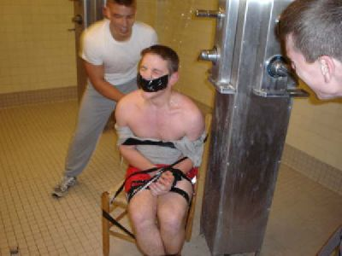
Defining Hazing
The National Federation of State High School Associations (NFHS), defines hazing as any humiliating or dangerous activity expected of a student to belong to a group, regardless of their willingness to participate.

Slide 8
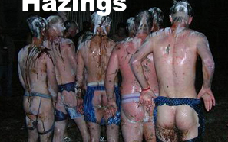
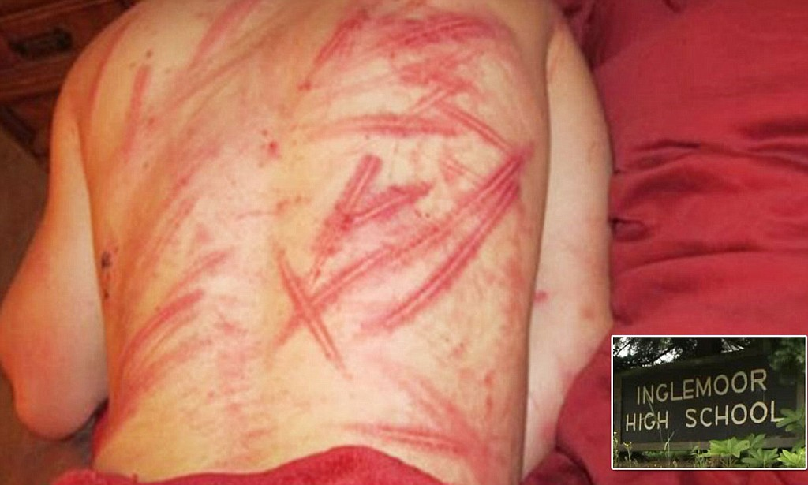
Defining Hazing (continued)
Some practices associated with high school hazing carry the potential for serious bodily harm or even death.
These practices may include: tattooing, piercing, head-shaving, branding, sleep deprivation, physical punishment (paddling and “red bellying”), ”kidnapping”, consuming unreasonable/unacceptable foods or beverages, being deprived of personal hygiene and/or inappropriate sexual behavior.

Slide 9
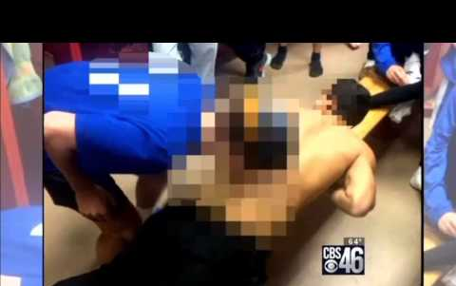
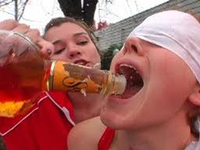
Defining Hazing (continued)
Coerced sexual activity, in addition to being classified as sexual assault and/or rape, is another form of hazing. Such activity puts victims at risk for injuries, sexually transmitted diseases, and pregnancy.
Alcohol abuse is another significant factor in hazing incidents that feature forced consumption of large amounts of alcohol.

Slide 10
Recognizing Hazing
Like domestic violence victims, victims of hazing may hide the true cause of their injuries.
Anyone working with those who may be hazing victims should assure them that they are safe and protected from possible retribution.
Some risk factors to bear in mind are: age, participation in athletic or military activities, and involvement of alcohol use.

Slide 11
Recognizing Hazing (continued)
A student who is being hazed may exhibit excessive fatigue, appear disheveled, or wear off clothing.
They may isolate themselves from friends and family, skip/miss classes due to lack of sleep at night and/or feel depressed.
Comments such as “hell week” or even the innocent sounding “help week” or “initiation”, may indicate hazing activity is taking place. It may be wise to ask the student questions to find out exactly what is involved.
Many times innocuous-sounding terms are actually euphemisms for hazing. “Code Reds”
- Turning off the lights or flickering the lights on and off in the locker may indicate that something is about to occur.

Slide 12
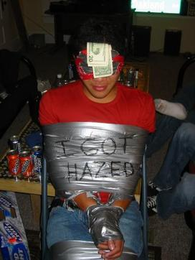
Recognizing Hazing (continued)
Members justifying an activity by saying ”It’s tradition”.
The presence of alcohol.
Secrecy. (“Cloak of Secrecy” or “Code of Silence”)
Peer pressure for everyone to participate.
Singling out an individual or specific group.
Miscellaneous bad judgment.

Slide 13
Bottom line…
Hazing arises in two ways:
1. Lack of Supervision
2. Failure to Address it
What we allow, we condone!

Slide 14
Lessons from Ooltewah and Damascus…
Ooltewah High School
(Hamilton County Dept. of Education, TN)
Damascus High School
(Montgomery County Public Schools, MD)

Slide 15
Duty to Supervise (Specific & General)
Responsibility of every Coach (and Athletic Director).
Chain of potential vicarious liability.
VISION & VOICE
- Coaches need to be VISIBLE – be a “Presence”.
- Coaches need to be VOCAL – define expectations for student-athlete behavior.
Student-athletes need to know that the locker room is a place where adults will be present and will be part of the scene.
Lessening the risks in the locker room takes foresight and leadership.

Slide 16
From the Pages of LTC 504: Risk Management (14 Categories of Legal Duties of Athletics Personnel)
Planning
Supervision
Selecting & Training Coaches
Warnings
Safe Playing Environment
All Other Legal Duties
Threshold of All Other Legal Duties
Chain of Vicarious Liability

Slide 17
Locker Room Supervision
What Athletic Directors Can Do:
Talk to Coaches – have the conversation…
Describe the expectations – show Coaches that the locker room isn’t the worse place to be.
Include all venues – (Including bus trips, etc.)
Check-in on Coaches (“Walk-Throughs”)
Meet regularly with struggling Coaches.
Pay attention…
Train personnel…as a matter of practice.
Review school district’s Hazing policy at EVERY Coaches’ meeting.
With more responsibility falling on Coaches – it is more important than ever to provide support.
Begin with yourself – What do you believe? What do you stand for?

Slide 18
Locker Room Supervision
What Athletic Directors can do: (continued)
11. Meet with/collaborate with the Physical Education staff.
12. Along with providing strict rules and a plan for supervision, Athletic Directors (and Coaches) need to set the tone for safety in the locker room.
❖
Athletic Directors need to talk to coaches, teachers, and administrators about the potential hazards of the locker room.
Explain the importance of supervising this area.
Ask staff members to put this venue on their radar screen – to check out the locker room anytime they are in the area.

Slide 19
Locker Room Monitoring & Supervision
Tips and Techniques:
Coaching staffs rotate – have assistant coaches take turns
Assign an out-of-season coach
Hire a monitor to supervise the locker room (Male coaches coaching a female team and vise-versa)
Utilize equipment managers, maintenance personnel
“All-in and All-out” together plan
Provide training to any persons supervising the locker room
Present a Locker Room Supervision Plan to your School Board – get their ‘buy-in’ (This is moving you one-step closer to eliminating hazing in your program.)

Slide 20
Recommendations for Athletic Directors:
Make a commitment to “change the culture”.
Ensure “buy-in” from school administration and school board.
Know and understand the school district’s anti-hazing policy.
Be available to your coaches to listen and react to their concerns.
Create an environment of trust, respect, and sincere concern.
Hold the difficult conversations with your coaches.
Send a clear message that hazing will not be tolerated.
Train staff to recognize signs of hazing and proper locker room supervision.
Do the right thing for kids – keep kids safe.
Education-Based Athletics

Slide 21
RESOURCES
National Federation of State High School Associations www.nfhslearn.org
Stop Hazing www.stophazing.org
Hazing Prevention www.hazingprevention.org
Alfred University Report www.Alfred.edu/hs.hazing
Hank Nuwer www.hazing.hanknuwer.com
Scott Rosberg – “The Locker Room: Creating a Culture of Success” www.greatresourcesforcoaches.com
Proactive Coaching www.proactivecoaching.info
“Google”: “MCPS Athletics Supervision Action Plan” & “ACP-E Supervision & Locker Room Plan”
Safe Sport www.uscenterforsafesport.org

Slide 22
FREE Courses: Bullying, Hazing and Inappropriate Behaviors Hazing Prevention for Students New Protecting Students from Abuse

Slide 23
Title IX New Regulations

Slide 24
General Concepts About Title IX of the Education Amendments of 1972
Title IX is the first comprehensive federal law that prohibits sex discrimination in education programs and activities that receive Federal financial assistance.
Title IX does not only pertain to sports. Title IX is not a sports law. The OCR considers athletics an education program.
Title IX does not only protect females. It protects all students (boys & girls), faculty and staff.
Title IX covers sexual harassment/sexual assault in schools.
Title IX requires schools to maintain policies, practices and programs that do not discriminate against anyone based on sex.
Title IX is at the heart of efforts to create gender equitable schools. Males and females are expected to receive fair and equitable treatment in all arenas of public schooling.

Slide 25
What Does Title IX Cover?
Sex Discrimination
Sexual Harassment
Program Equity
Recruitment, Admissions and Access Pregnancy
Athletics
Employment, Recruitment & Hiring
Extra-curricular activities
Housing
Access to Course Offerings
Salaries & Benefits
Financial Assistance
Facilities
Funding
Sex, Gender, Gender Identity
Sexual Harassment --------------→
Stalking
Domestic Violence
Dating Violence
Sexual Assault (Hazing)
Sexual Violence
Sexual Exploitation
Sexual Intimidation
Sexual Misconduct
Bullying and Cyberbullying
Retaliation

Slide 26
New Title IX Regulations – Issued 5/6/2020
On May 6, 2020, the US Department of Education issued its final (new) regulations concerning sexual harassment and sexual assault in K-12 schools, colleges and universities. The new regulations, which take effect on August 14, 2020, include some significant changes in the requirements for schools that receive complaints of sexual harassment. While many changes effect higher education institutions, the most dramatic changes apply to elementary and secondary schools (K-12).

Slide 27
What the New Title IX Regulations mean to K-12 Athletic Administrators
There are no recommended changes to Title IX compliance relative to athletics.
The duties and obligations that schools have regarding the application of Title IX in athletics remains the same.
The changes to the Title IX Regulations apply to the manner and methodology in the way schools process and investigate complaints of sexual harassment/
sexual assault.
K-12 Athletic Administrators should work with the school district’s Title IX Coordinator when addressing incidents of sexual harassment.
Changes Effect:
- Th definition of sexual harassment.
- The breadth of circumstances where Title IX applies.
- Liability with respect to institutional notice.
- Liability regarding institutional action.
-Requirements associated with grievance procedures.

Slide 28
What Schools Must Do:
Revise policies, guidelines and forms.
Identify the school district’s Title IX Coordinator.
Identify who is on the school district’s Title IX Team.
Provide necessary training.
Develop templates, notices, and forms.
Consider implications for student and staff discipline.
Update record retention process.
Post required notices and training materials.

Slide 29
Title IX
TITLE IX COMPLIANCE FRAMEWORK
COMPONENT I: SPORTS OFFERINGS
A. Participation Offerings - The Three Prong Test
 Substantial Proportionality or
 History & Continuing Practice of Program Expansion or
 Full & Effective Accommodation Of Athletic Interests
B. Levels Of Competition - The Two Prong Test
 Equivalently Advanced Competitive Opportunities or
 History & Continuing Practice Of Improvement
COMPONENT II: ATHLETIC SCHOLARSHIPS (Not HS/MS)
COMPONENT III: OTHER ATHLETICS BENEFITS
P - L - A - Y - I - N - G F - A - I - R

Slide 30
LTI 506 Legal Issues II: Title IX and Sexual Harassment

Slide 31
Title IX Resources
Association of Title IX Administrators (ATIXA) www.atixa.org
Title IX Clearinghouse www.titleix.com
Education Risk Management www.EduRisksolutions.org
National Women’s Law Center www.nwlc.org
Stop Sexual Assault In Schools www.stopsexualassaultinschools.org
Title IX Today https://titleix.today/

Slide 32
Transgender Student-Athletes

Slide 33
TRANSGENDER PARTICIPATION IN SCHOOL SPORTS
Sources of Law: Federal & State
 14TH Amendment Equal Protection Clause  Title IX Of The Education Amendments Of 1972
 U.S. Dept. Of ED. OCR & Dept. Of Justice Civil Rights Division Dear Colleague Letter Of May 13, 2016
U.S. Dept. Of ED. Policy Guidance Of May 2016
The Matthew Shepard Hate Crimes Prevention Act
Employment Non-Discrimination Act [ENDA]
Student Non-Discrimination Act [SNDA]
State Laws Prohibiting Workplace Discrimination Based On Sexual Orientation & Gender Identity
State Laws Prohibiting Discrimination In Schools Based On Sexual Orientation & Gender Identity
State Laws Prohibiting Bullying Of Students Based On Sexual Orientation Or Gender Identity
School District Policies Prohibiting Discrimination Based On Sexual Orientation Or Gender Identity
Student Privacy Regarding Sexual Orientation Or Gender Identity Status

Slide 34
TRANSGENDER PARTICIPATION IN SCHOOL SPORTS
G.G. v. Gloucester County School Board U.S. District Court – August 9, 2019
Ruling By The Federal Court:
In March 2017, the U.S. Supreme Court was to hear the appeal of the Fourth Circuit’s 2016 decision in favor of G.G., but based on the new administration’s policy regarding transgender students, the Court remanded the case to a lower court for a rehearing.
On August 9, 2019, that lower federal court ruled that the refusal by a school to allow the use by transgender students of school facilities (such as restrooms) consistent with their gender identity is unlawful because it constitutes gender discrimination specifically prohibited under Title IX of the Education Amendments of 1972 and the Equal Protection Clause in the 14th Amendment to the U.S. Constitution.

Slide 35
TRANSGENDER PARTICIPATION IN SCHOOL SPORTS
Doe v. Boyertown Area School District U.S. Third Circuit – July 26, 2018 U.S. Supreme Court Cert Denied – May 28, 2019
Ruling By The Court Of Appeals:
The privacy rights of cisgender students having to encounter transgender students in restrooms and locker rooms were not violated because of privacy alternatives offered by Boyertown Area Senior High School (PA). The refusal by a school to allow the use by transgender students of school facilities consistent with their gender identity is unlawful because such a restriction constitutes gender discrimination specifically prohibited under Title IX because the definition of sex in the law is based on a person’s gender identity, not his or her anatomical gender at birth.

Slide 36
TRANSGENDER PARTICIPATION IN SCHOOL SPORTS
Soule, et al v. Connecticut IAC Title IX Complaint Filed With U.S. Dept of Ed’s Office For Civil Rights (OCR) – June 19, 2019
Allegations In OCR Complaint:
The CIAC is one of 19 state associations that have fully inclusive policies that allow transgender athletes to compete without restrictions based on gender identity.
The complaint was filed after two transgender girls won events at the indoor and outdoor state meets and alleges a deprivation of equal protection for cisgender girls competing at CIAC events and a deprivation of possible college scholarships.
This case continues to evolve…

Slide 37
TRANSGENDER PARTICIPATION IN SCHOOL SPORTS
Harris Funeral Homes v. EEOC Transgender Case On Workplace Discrimination Argued Before U.S. Supreme Court – Oct 8, 2019
Summary Of Case:
Aimee Stephens was fired because she is transitioning from male to female and the Court agreed to hear the case to resolve the issue whether the word “sex” in Title VII (prohibiting workplace sex discrimination) means only gender at birth or includes gender identity. Note possible impact of outcome on schools via Title IX.
Questions were asked by the justices about restrooms, locker rooms, and participation in sports, but Stephens’ lawyers dodged those by focusing only on firing/hiring/workplace issues related to being transgender.
Decision Expected In June or July 2020

Slide 38
A number of states have recently introduced or have passed legislation that would require transgender athletes to compete as the gender on their birth certificate. Georgia, Tennessee, Washington, Missouri, Texas, Louisiana, Arizona, Alabama have either passed legislation or have pending legislation regarding transgender student participation in athletics.

Slide 39
Resources

Slide 40
Transathlete.com

Slide 41
Social Media Policy

Slide 42
Important STUDENT FREE SPEECH COURT CASES
Tinker v. Des Moines Independent School District
Bethel School District v. Fraser
Hazelwood School District v. Kuhlmeier
Morse v. Frederick
Killion v. Franklin Regional School District
Lowery v. Euverard
Pinard v. Clatskanie School District
Bell v. Itawamba School District
Doninger v. Niehoff
J.S. v. Blue Mountain School District
Layshock v. Hermitage School District
Kowalski v. Berkeley County Schools
D.J.M. v. Hannibal Public School District
Wynar v. Douglas County School District
T.V & M.K. v. Smith-Green Community Schools
Rosario v. Clark County School District

Slide 43
STUDENT FREE SPEECH
Levy (B.L.) v. Mahanoy Area School District
U.S. District Court (PA) granted summary judgment – March 2019
Summary Of Case:
A cheerleader (B.L.) was dismissed from the squad for inappropriate postings on social media allegedly in violation of the student-athlete code of conduct at Mahanoy Area High School, concluding that her communications were constitutionally protected by the Free Speech Clause of the First Amendment, and making permanent the temporary injunction restoring her to the cheer team that had been issued in October 2017 by the same federal court.

Slide 44
SOCIAL MEDIA POLICY RECOMMENDATIONS
Include a social media policy in your student-athlete code of conduct.
Begin the policy with a statement of purpose explaining the disruptive impact of inappropriate social media postings on the school, on the athletics program, and on the morale and success of the team.
Avoid generalized, morals clause type language in the policy.
Include “participation is a privilege not a right” language.

Slide 45
SOCIAL MEDIA POLICY RECOMMENDATIONS
Include precise language defining the specific prohibited behaviors:
Sexually explicit, profane, lewd, indecent, or defamatory language.
Derogatory language regarding school personnel or other students.
Comments designed to harass or bully students/school personnel.
Nude/sexually-oriented/indecent photos/images or altered pictures.

Slide 46
SOCIAL MEDIA POLICY RECOMMENDATIONS
Document all on-campus connections to off-campus violations of the policy.
Use of school computers to view the off-campus postings.
Extent of students accessing posts at school on their own devices.
Distribution of hard copies of posts on school property.
Extent of re-communication on campus of the content of the original posts.

Slide 47
SOCIAL MEDIA POLICY RECOMMENDATIONS
Document all on-campus disruptive impacts of off-campus postings.
Disruptions that occur in class or during curricular activities.
Disruptions that occur anywhere on school property or at school events.
Disruptions that constitute in any way harassment or bullying.
Disruptions to sports teams that impact morale, discipline, or team cohesiveness.

Slide 48
General Issues Facing Athletic Departments

Slide 49
General Issues Facing Athletic Departments
Vaping & Due Process
L.H. v. Lawrenceburg Community School Corporation (2019)
Superior Court judge ruled that the district did not violate the due process rights of a football player caught with a vape pen in violation of the student-athlete code of conduct regarding possession of alcohol, tobacco, or drugs by suspending him for five of the team’s nine games scheduled for the 2019 season.
Vega v. North Canto Central School District (2019)
A state trial court refused a request to rehear its October 2017 dismissal of a suit by a high school football player who was attempting to challenge his suspension for the remainder of the season for violating the chemical abuse provisions in his school’s Student-Athlete Code of Conduct, a policy that explicitly covered tobacco and the possession or use of all tobacco-related products, including e-cigarettes, vape pens, and JUULs.

Slide 50
General Issues Facing Athletic Departments
Religion and Prayer
Kennedy v. Bremerton School District (2020)
A U.S. District Court judge ruled against an attempt by former Bremerton High School coach Joe Kennedy to resurrect his freedom of religious expression lawsuit.
Santa Fe ISD, Doe (2000)
A U.S. Supreme Court ruling in which the Court held that prayer at sports events sponsored by “state actors” violates the Establishment Clause of the First Amendment.

Slide 51
General Issues Facing Athletic Departments
COVID 19 and Return to Play
NFHS – “Guidance For Opening Up High School Athletics and Activities”
School District Policies
Federal, State and Local Policies
Who is part of the process? School Board, Superintendent, Athletic Director, Coaches, Support Staff, etc.

Slide 52
RESOURCES
NIAAA LTI Legal Courses (4) www.nfhs.org
NFHS Learn Courses www.NFHSLearn.org
Common Sense (social media) www.commonsensemedia.org
US Center for Safe Sport www.uscenterforsafesport.org
Your State Athletic Association
Your State Athletic Administrator’s Association
Your State Department of Education
School District Policies

Slide 53
Thank you for all that you do for kids! Education-Based Athletics!

Slide 54
Thank You!
We are here to assist you…
Peg Pennepacker, CAA
pegpennepacker@gmail.com
814-470-7101
Dan Armstrong, CAA
Daniel.armstrong@nwsc.k12.in.us
765-457-8101 Ext. 2033

